Slide 1
Introduction to
Computer Graphics with OpenGL/GLUT

Slide 2
What is OpenGL?
A software interface to graphics hardware
Graphics rendering API
  High-quality color images composed of geometric and image primitives
  Operating system independent
Notes:
Application Programming Interface

Slide 3

OpenGL Basics
Rendering (to generate realistic images)
  Typically execution of OpenGL commands
  Converting geometric/mathematical object descriptions into frame buffer values
OpenGL can render:
  Geometric primitives
    Lines, points, polygons, etc…
  Images
    Images and geometry linked through
    texture mapping
Graphics Pipeline

Slide 4
OpenGL and GLUT
GLUT (OpenGL Utility Toolkit)
  A library
    A portable windowing API
    Easier to show the output of your OpenGL application
    Not officially part of OpenGL
  Handles:
    Window creation,
    OS system calls
      Mouse buttons, movement, keyboard, etc…
    Callbacks

Slide 5
Callback
A callback function is a function which the library (GLUT) calls when it needs to know how to process something. e.g. when glut gets a key down event it uses the glutKeybourdFunc callback routine to find out what to do with a key press.

Slide 6
How to install GLUT?
Download GLUT
  http://www.opengl.org/resources/libraries/glut.html
Copy the files to following folders:
  glut.h → VC/include/gl/
  glut32.lib → VC/lib/
  glut32.dll → windows/system32/
Header Files:
  #include <GL/glut.h>
  #include <GL/gl.h>
  Include glut automatically includes other header files
  http://www.cse.iitm.ac.in/~vplab/courses/CG/opengl_start.html

Slide 7
Sample Program
#include <GL/glut.h>
#include <GL/gl.h>
void main(int argc, char** argv)
{
glutInitDisplayMode(GLUT_RGB|GLUT_DOUBLE);
glutInitWindowSize( 500,500 );
glutCreateWindow( “Simple” );
init();
glutDisplayFunc( display );
glutKeyboardFunc( key );
glutMainLoop();
}

Slide 8
Sample Program
#include <GL/glut.h>
#include <GL/gl.h>
void main(int argc, char** argv)
{
glutInitDisplayMode(GLUT_RGB|GLUT_DOUBLE);
glutInitWindowSize( 500,500 );
glutCreateWindow( “Simple” );
init();
glutDisplayFunc( display );
glutKeyboardFunc( key );
glutMainLoop();
}
Specify the display
Mode – RGB or color
Index, single or double
Buffer

Slide 9
Sample Program
#include <GL/glut.h>
#include <GL/gl.h>
void main(int argc, char** argv)
{
int mode = GLUT_RGB|GLUT_DOUBLE;
glutInitDisplayMode( mode );
glutInitWindowSize( 500,500 );
glutCreateWindow( “Simple” );
init();
glutDisplayFunc( display );
glutKeyboardFunc( key );
glutMainLoop();
}
Create a window
Named “simple”
with resolution
500 x 500

Slide 10
Sample Program
#include <GL/glut.h>
#include <GL/gl.h>
void main(int argc, char** argv)
{
int mode = GLUT_RGB|GLUT_DOUBLE;
glutInitDisplayMode( mode );
glutInitWindowSize( 500,500 );
glutCreateWindow( “Simple” );
init();
glutDisplayFunc( display );
glutKeyboardFunc( key );
glutMainLoop();
}
Your OpenGL initialization
code (optional)

Slide 11
Sample Program
#include <GL/glut.h>
#include <GL/gl.h>
void main(int argc, char** argv)
{
int mode = GLUT_RGB|GLUT_DOUBLE;
glutInitDisplayMode( mode );
glutInitWindowSize( 500,500 );
glutCreateWindow( “Simple” );
init();
glutDisplayFunc( display );
glutKeyboardFunc(key);
glutMainLoop();
}
Register your call back
functions

Slide 12
glutMainLoop()
#include <GL/glut.h>
#include <GL/gl.h>
int main(int argc, char** argv)
{
int mode = GLUT_RGB|GLUT_DOUBLE;
glutInitDisplayMode(mode);
glutInitWindowSize(500,500);
glutCreateWindow(“Simple”);
init();
glutDisplayFunc(display);
glutKeyboardFunc(key);
glutMainLoop();
}
The program goes into an infinite
loop waiting for events

Slide 13
GLUT Callback functions
Event-driven: Programs that use windows
  Input/Output
  Wait until an event happens and then execute some pre-defined functions according to the user’s input
Events – key press, mouse button press and release, window resize, etc.
Your OpenGL program will be in infinite loop

Slide 14
GLUT Callback Functions
Callback function : Routine to call when an event happens
  Window resize or redraw
  User input (mouse, keyboard)
  Animation (render many frames)
“Register” callbacks with GLUT
  glutDisplayFunc( my_display_func );
  glutIdleFunc( my_idle_func );
  glutKeyboardFunc( my_key_events_func );
  glutMouseFunc ( my_mouse_events_func );

Slide 15
Event Queue
Keyboard
Event queue
….
MainLoop()
Mouse
Window
Mouse_callback()
{
….
{
Keypress_callback()
{
….
{
window_callback()
{
….
{

Slide 16
Rendering Callback
Callback function where all our drawing is done
Every GLUT program must have a display callback
glutDisplayFunc( my_display_func ); /* this part is in main.c */
  void my_display_func (void )
  {
  glClear( GL_COLOR_BUFFER_BIT );
  glBegin( GL_TRIANGLE );
  glVertex2f( v[0] );
  glVertex2f( v[1] );
  glVertex2f( v[2] );
  glEnd();
  glFlush();
  }

Slide 17
User Input Callbacks
Process user input
glutKeyboardFunc( my_key_events );
  void my_key_events (char key, int x, int y )
  {
  switch ( key ) {
  case ‘q’ : case ‘Q’ :
  exit ( EXIT_SUCCESS);
  break;
  case ‘r’ : case ‘R’ :
  glClearColor(0,0,0,1);
  break;
  }
  }

Slide 18
Mouse Callback
Captures mouse press and release events
glutMouseFunc( my_mouse );
  void myMouse(int button, int state, int x, int y)
  {
      if (button == GLUT_LEFT_BUTTON && state == GLUT_DOWN)
      {
      …
      }
  }

Slide 19
Events in OpenGL
Event | Example | OpenGL Callback Function
Keypress | KeyDown KeyUp | glutKeyboardFunc
Mouse | leftButtonDown leftButtonUp | glutMouseFunc
Motion | With mouse press Without | glutMotionFunc glutPassiveMotionFunc
Window | Moving Resizing | glutReshapeFunc
System | Idle Timer | glutIdleFunc glutTimerFunc
Software | What to draw | glutDisplayFunc

Slide 20
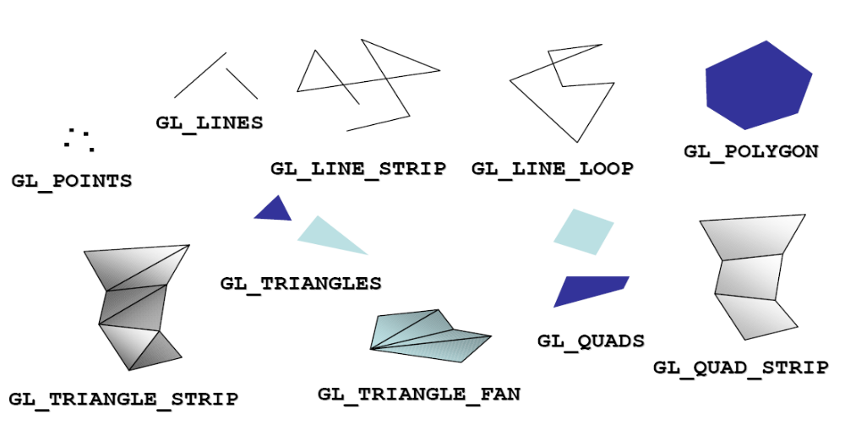
OpenGL Geometric Primitives
The geometry is specified by vertices.
There are ten primitive types:

Slide 21
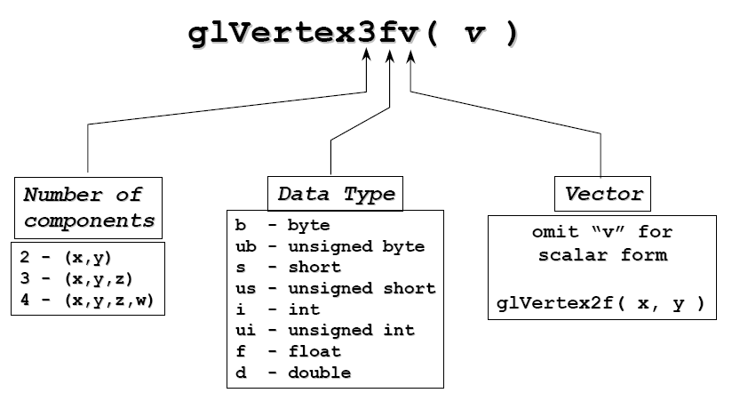
OpenGL Command Format
glVertex3fv

Slide 22
Vertices and Primitives
Primitives are specified using
  glBegin( primType );
  …
  glEnd();
  primType determines how vertices are combined
  glBegin( primType );
  glVertex3f(x,y);
  glEnd();

Slide 23
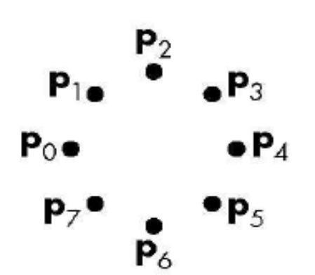

Vertices and Primitives
Points, GL_POINTS
  Individual points
  Point size can be altered
    glPointSize (float size)
glBegin(GL_POINTS);
  glColor3f( color );
  glVertex2f( P0.x, P0.y );
  glVertex2f( P1.x, P1.y );
  glVertex2f( P2.x, P2.y );
  glVertex2f( P3.x, P3.y );
  glVertex2f( P4.x, P4.y );
  glVertex2f( P5.x, P5.y );
  glVertex2f( P6.x, P6.y );
  glVertex2f( P7.x, P7.y );
  glEnd();

Slide 24
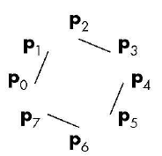
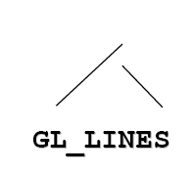
Vertices and Primitives
Lines, GL_LINES
  Pairs of vertices interpreted as individual line segments
  Can specify line width using:
    glLineWidth (float width)
glBegin(GL_LINES);
  glColor3fv( color );
  glVertex2f( P0.x, P0.y );
  glVertex2f( P1.x, P1.y );
  glVertex2f( P2.x, P2.y );
  glVertex2f( P3.x, P3.y );
  glVertex2f( P4.x, P4.y );
  glVertex2f( P5.x, P5.y );
  glVertex2f( P6.x, P6.y );
  glVertex2f( P7.x, P7.y );
  glEnd();

Slide 25

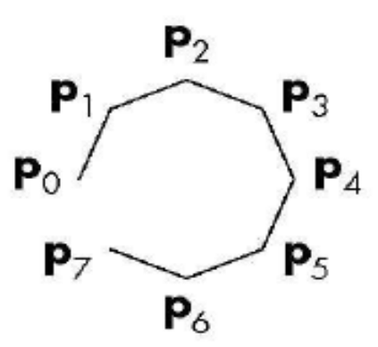
Vertices and Primitives
Line Strip, GL_LINE_STRIP
  series of connected line segments

Slide 26
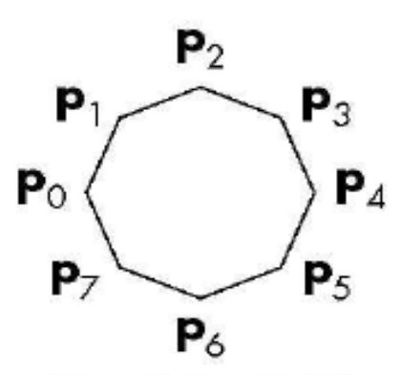

Vertices and Primitives
Line Loop, GL_LINE_LOOP
  Line strip with a segment added between last and first vertices

Slide 27

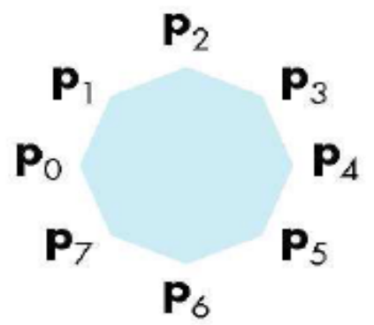
Vertices and Primitives
Polygon , GL_POLYGON
  boundary of a simple, convex polygon

Slide 28
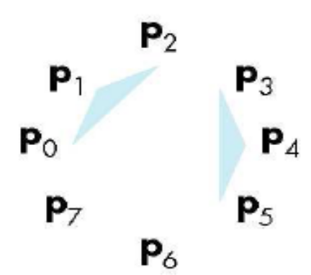

Vertices and Primitives
Triangles , GL_TRIANGLES
  triples of vertices interpreted as triangles

Slide 29

Vertices and Primitives
Triangle Strip , GL_TRIANGLE_STRIP
  linked strip of triangles
v0
v1
v2
v3
v4
v5
v7
v6

Slide 30

Vertices and Primitives
Triangle Fan , GL_TRIANGLE_FAN
  linked fan of triangles
v1
v2
v3
v4
v0
v5

Slide 31


Vertices and Primitives
Quads , GL_QUADS
  quadruples of vertices interpreted as four-sided polygons

Slide 32
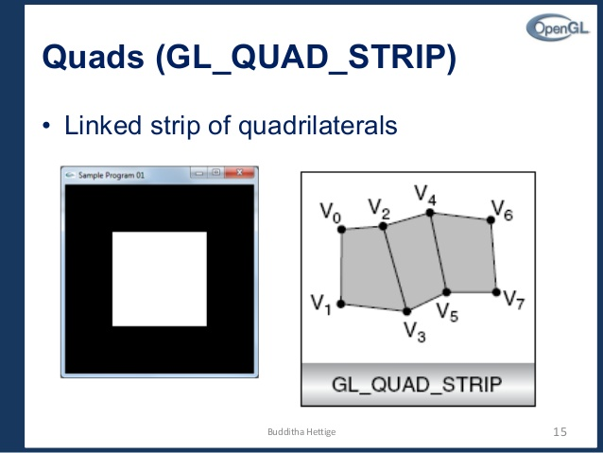
Vertices and Primitives
Quads , GL_QUAD_STRIP
  Linked strip of quadrilaterals

Slide 33
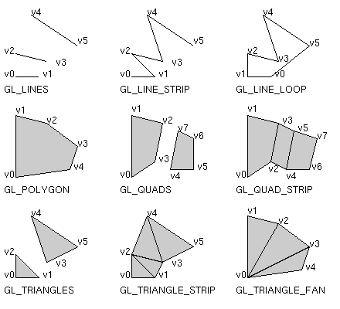
Vertices and Primitives

Slide 34
Vertices and Primitives
Between glBegin/ glEnd, those opengl commands are allowed:
  glVertex*() : set vertex coordinates
  glColor*() : set current color

Slide 35
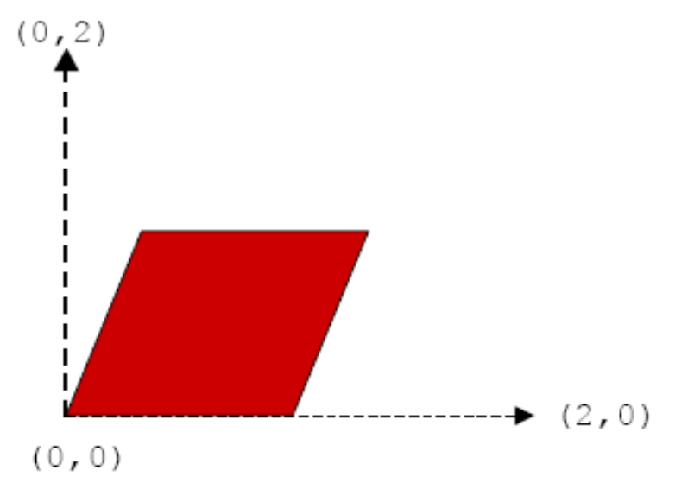
An Example
void drawParallelogram( )
{
  glBegin( GL_QUADS );
  glVertex2f( 0.0, 0.0 );
  glVertex2f( 1.0, 0.0 );
  glVertex2f( 1.5, 1.118 );
  glVertex2f( 0.5, 1.118 );
  glEnd();
}

Slide 36
References
http://www.opengl.org/documentation/spec.html
http://www.opengl.org/documentation/red_book_1.0/
http://www.cs.rit.edu/~jdb/cg1/openGLIntro.pdf
http://www.ceng.metu.edu.tr/courses/ceng477/2005/documents/recitations/opengl.ppt

